Slide 1
ARRAY FORMULAS
More formulas in excel

Slide 2
Array formulas
Array formulas are powerful formulas that enable you to perform complex calculations that often can’t be done with standard worksheet functions.
They are also referred to as "Ctrl-Shift-Enter" or "CSE" formulas, because you need to press Ctrl+Shift+Enter to enter them.
You can use array formulas to do the seemingly impossible, such as:
Count the number of characters in a range of cells.
Sum numbers that meet certain conditions, such as the lowest values in a range or numbers that fall between an upper and lower boundary.
Sum every nth value in a range of values.

Slide 3

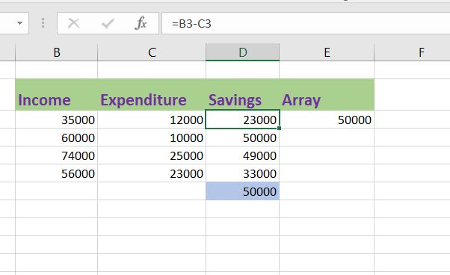
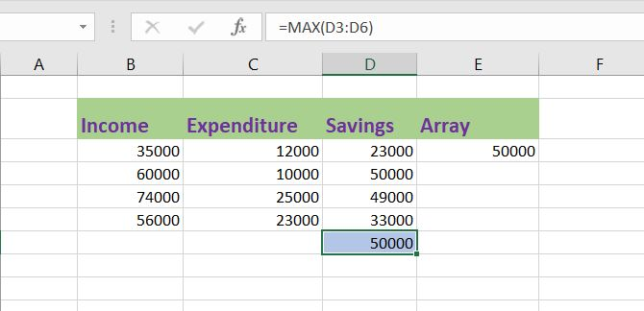
Without array formula
To calculate Maximum of savings, when we are given with Income and Expenditure. If we don’t use Array formulas, first we need to calculate savings by subtracting Expenditure from Income.
After that, we need to calculate Max of Savings to get the desired output that is 50,000

Slide 4
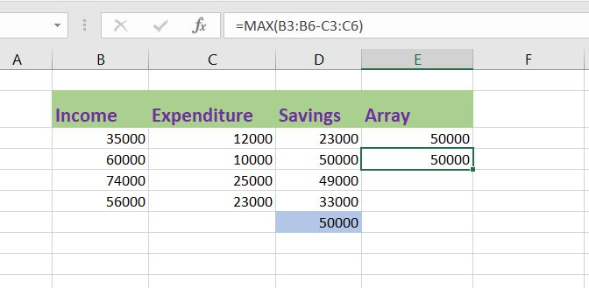
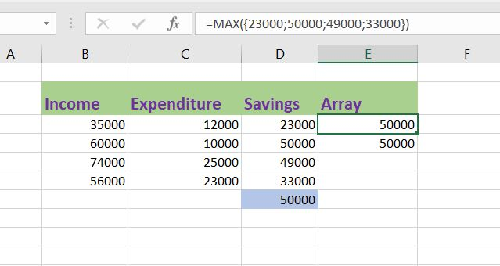
WITH ARRAY FORMULAS
We don't need to store the range in column D. Excel can store this range in its memory. A range stored in Excel's memory is called an array constant. Instead of using D column, use ranges such as B3:B6 and C3 :C6. Finish by pressing CTRL + SHIFT + ENTER.
Select B3:B6-C3:C6 in the formula. Press F9 and you will see that Elements in a vertical array constant are separated by semicolons. Elements in a horizontal array constant are separated by commas.

Slide 5
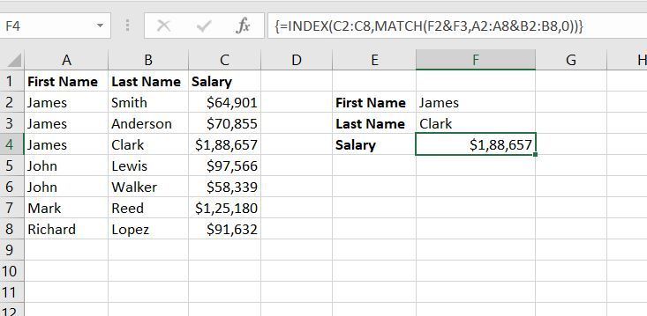
TWO Column LOOKUP
To join strings, use the & operator.
The MATCH function returns the position of a value in a given range. Insert the MATCH function shown below.
Finish by pressing CTRL + SHIFT + ENTER.
Use this result and the INDEX function to return the 3rd value in the range C2:C8
The range (array constant) A2:A8&B2:B8 is stored in Excel's memory, not in a range. The array constant looks as follows:
{"JamesSmith";"JamesAnderson";"JamesClark";"JohnLewis";"JohnWalker";"MarkReed";"RichardLopez"}
This array constant is used as an argument for the MATCH function, giving a result of 3 (JamesClark found at position 3).

Slide 6
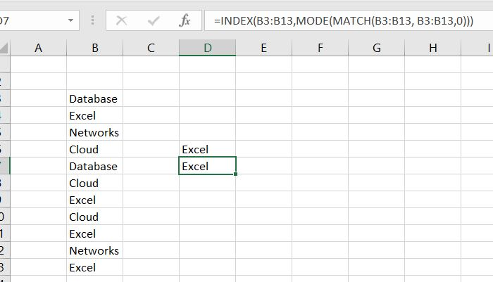
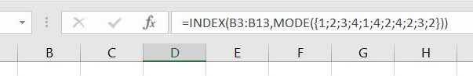
MOST FREQUENTLY OCCURING WORD
You can use the MODE function to find the most frequently occurring number. However, the MODE function only works with numbers.
The MATCH function returns the position of a value in a given range. To find the position of the most frequently occurring word ,we add the MODE function and B3:B13 with B3:B13
Use this result and the INDEX function to return the 2nd word in the range B3:B13, the most frequently occurring word.
The range (array constant) created by the MATCH function is stored in Excel's memory, not in a range. The array constant looks as __This array constant is used as an argument for the MODE function, giving a result of 2 (the position of the most frequently occurring word).

Slide 7
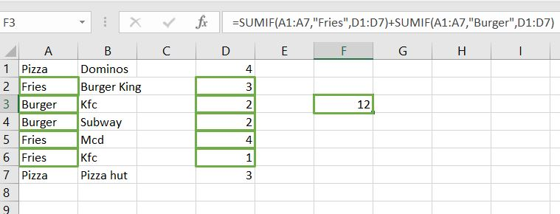
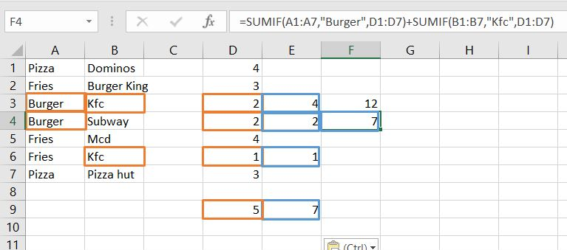
SUM WITH OR CRITERIA
Consider the example to the left. We want to calculate the sum of cells that meet one certain criteria that is Fries or Burger (ONE CRITERIA RANGE). It will give correct results in One range.
However, if we want to sum the cells that meet the following criteria: Burger or Kfc (two criteria ranges), we cannot simply use the SUMIF function twice (see the picture below). Cells that meet the criteria Burger and Kfc are added twice, but they should only be added once. 5 is the answer we are looking for, but here we got 7.

Slide 8
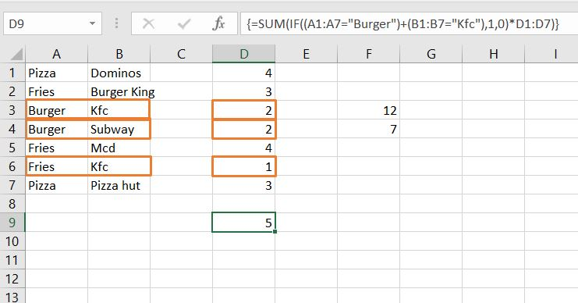
SUM WITH OR criteria
Use SUM function with If function where two conditions are Ored. If either is True, value will be 1 otherwise 0.
The range (array constant) created by the IF function is stored in Excel's memory, not in a range. The array constant looks as follows:
{1;0;1;0;1;0;1;0}
multiplied by D1:D7 this yields:
{0;0;2;2;0;1;0;0}
This latter array constant is used as an argument for the SUM function, giving a result of 5.

Slide 9
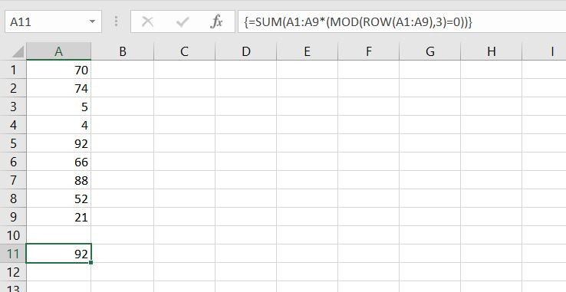
SUM every nth row
The MOD function gives the remainder of a division. For example, for the first row, MOD(1,3) equals 1. 1 is divided by 3 (0 times) to give a remainder of 1. For the third row, MOD(3,3) equals 0. 3 is divided by 3 (exactly 1 time) to give a remainder of 0. As a result, the formula returns 0 for every 3th row. Change the formula as shown.
The ROW function returns the row number of a cell.
To get the sum of the product of these two ranges (FALSE=0, TRUE=1), use the SUM function and finish by pressing CTRL + SHIFT + ENTER. The product of these two ranges (array constant) is stored in Excel's memory, not in a range. The array constant looks as follows.
{0;0;5;0;0;66;0;0;21}
This array constant is used as an argument for the SUM function, giving a result of 92.

Slide 10
SUM LARGEST NUMBERS
Do it Yourself!
Task -Create an array formula that sums largest numbers in a range.
Hint- You can use Sum and Large functions

